Slide 1
Access to historical geodata via Hungaricana Portal and Budapest Time Machine
Andras SIPOS
Budapest City Archives
siposa@bparchiv.hu
CEF eArchiving Building Block GEOPRESERVATION CONFERENCE
Ljubljana, 6-7 May 2019

Slide 2
Archival material – reservoir of spatial knowledge
Maps – storage and presentation of geoinformation
Archival records – full of embedded „hidden” geoinformation
Integration of digitized historical maps into GIS sytems and connecting with geodata extracted from records is an effective way of transformation of archival sources into spatial knowledge directly

Slide 3
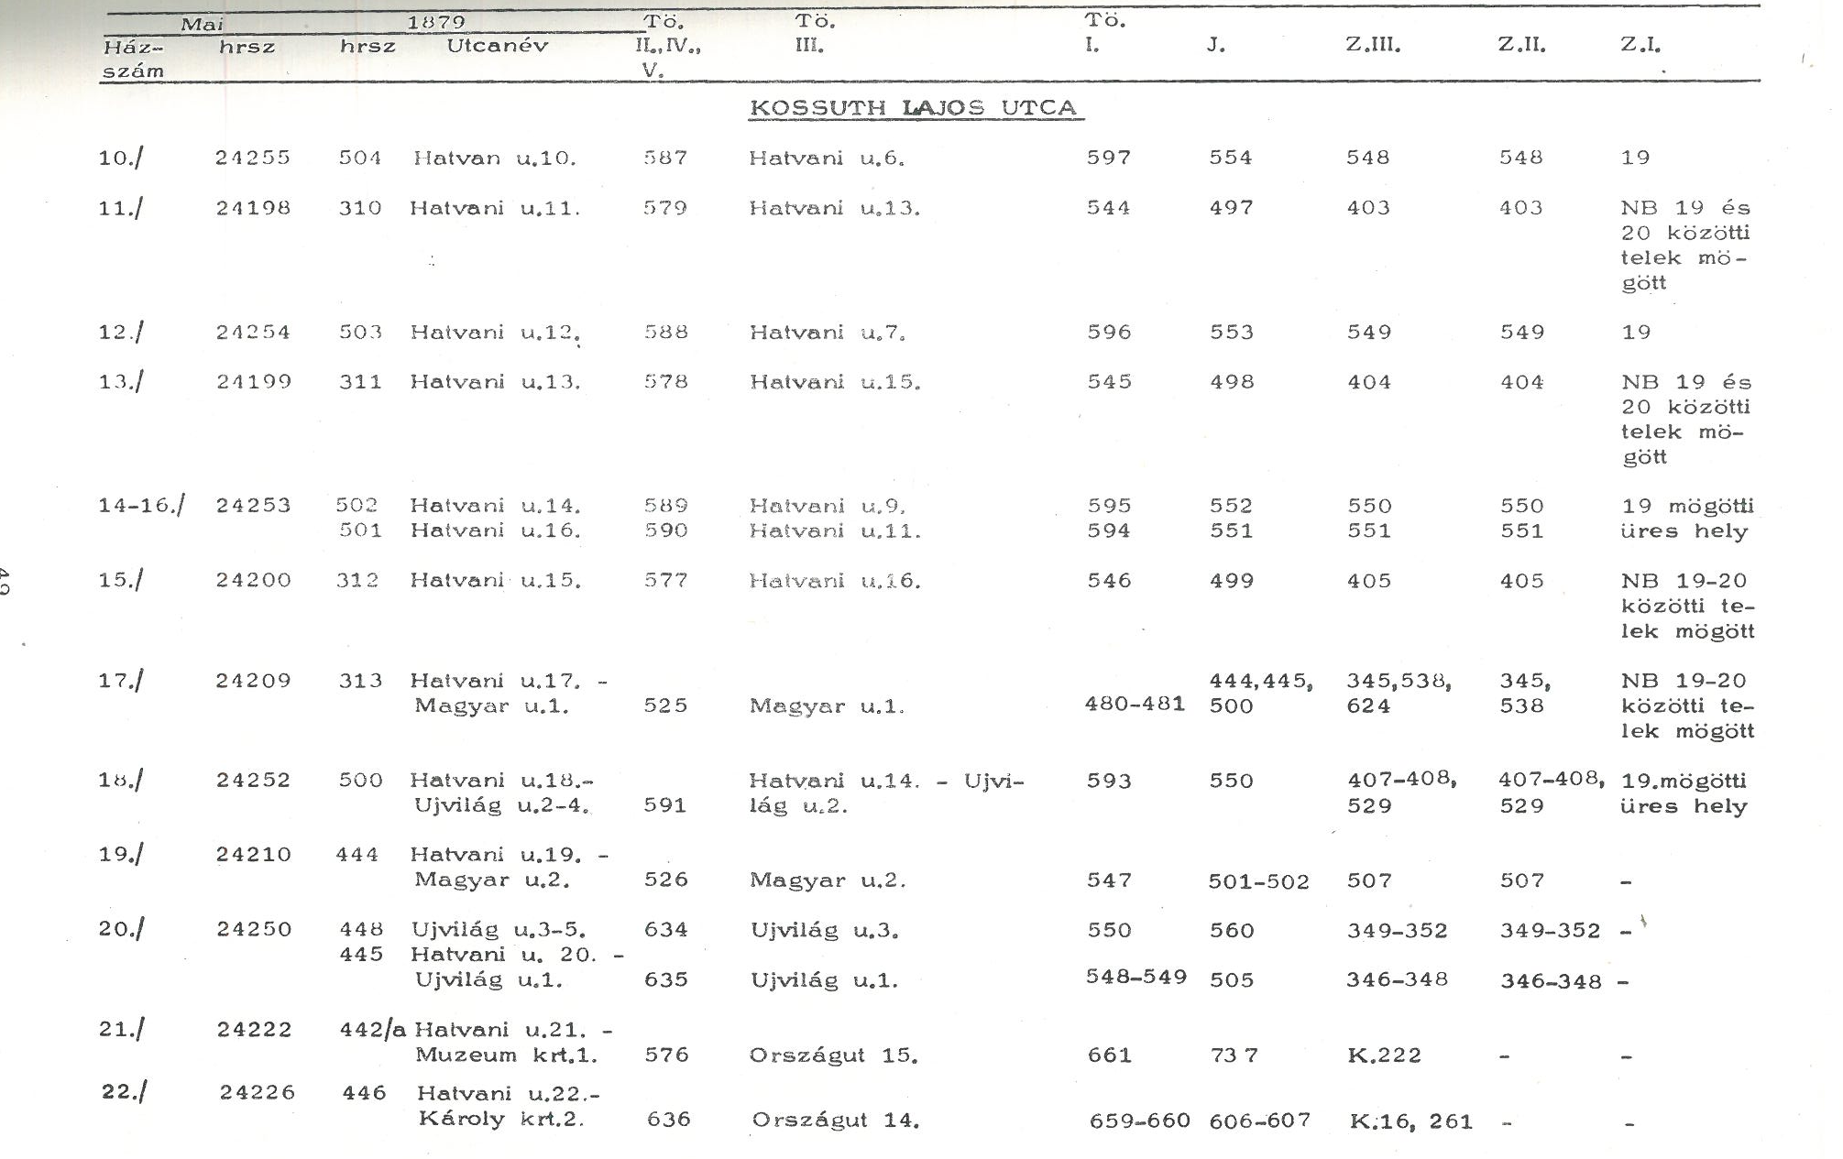
Step by step: from 1970s to the present and future…
1975- Databases of historical topography in printed form
Connection of contemporary adresses and property plot identifiers to historical house and plot numbers

Slide 4
2002 - Beginning of building of databases of mass records
Types of records
Notarial records
Last wills, testaments
Inheritence files
Court files (penalty and civil suits)
Orphans’ Offiece files
Registers of prisons and penitentiary institutions
Architectural plans
Land registry records
Recorded data types:
Reference code
Name (persons)
Role (of the person in the case)
Occupation
Adress
Date
Type of the case
Property plot number (contemporary)

Slide 5
2005 – Digitization of the Map Collection
DVD-publication: The Old Maps of Budapest I-IV.
(Based on the printed catalogue of the historical maps of Budapest published in 2003)
Developer and publisher: Arcanum Ltd.

Slide 6
2006-2007 – Digitization of architectural plans
Plans of Buda and Pest before the unification of cities (1873) and Miklós Ybl Collection
DVD-publication: The Old Plans of Budapest I.

Slide 7
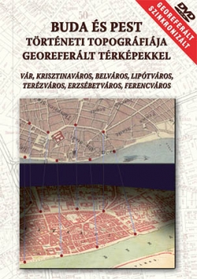
2007 – Transformation of historical topographies into electronic database
Georeferencing of digitized maps
DVD-publication: Historical topography of Buda and Pest with georeferenced maps
Scientific background: Department of Geophysics and Space Science, Eötvös Lorand University
Developer and publisher: Arcanum Ltd.

Slide 8
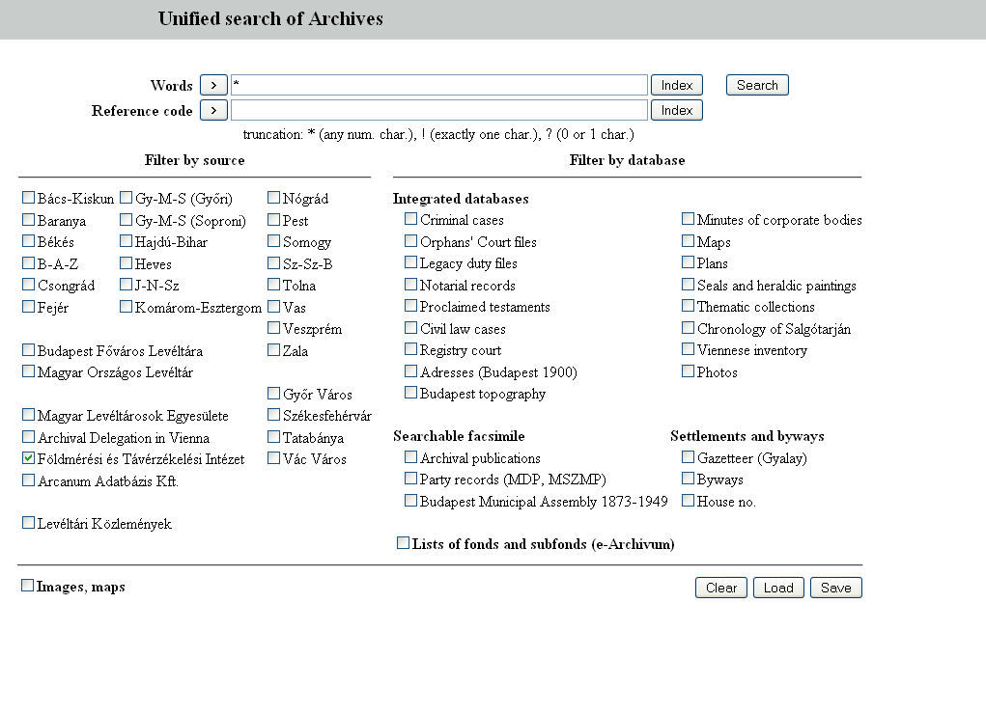
2009 – Hungarian Archives Portal
Joint Archival Database
On-line publication of databases of Budapest City Archives, search by on click in different databases / different archives
On-line publication of digitized and georeferenced maps
On-line publication of digitized plans and photos
http://mlp.archivportal.hu/en/

Slide 9
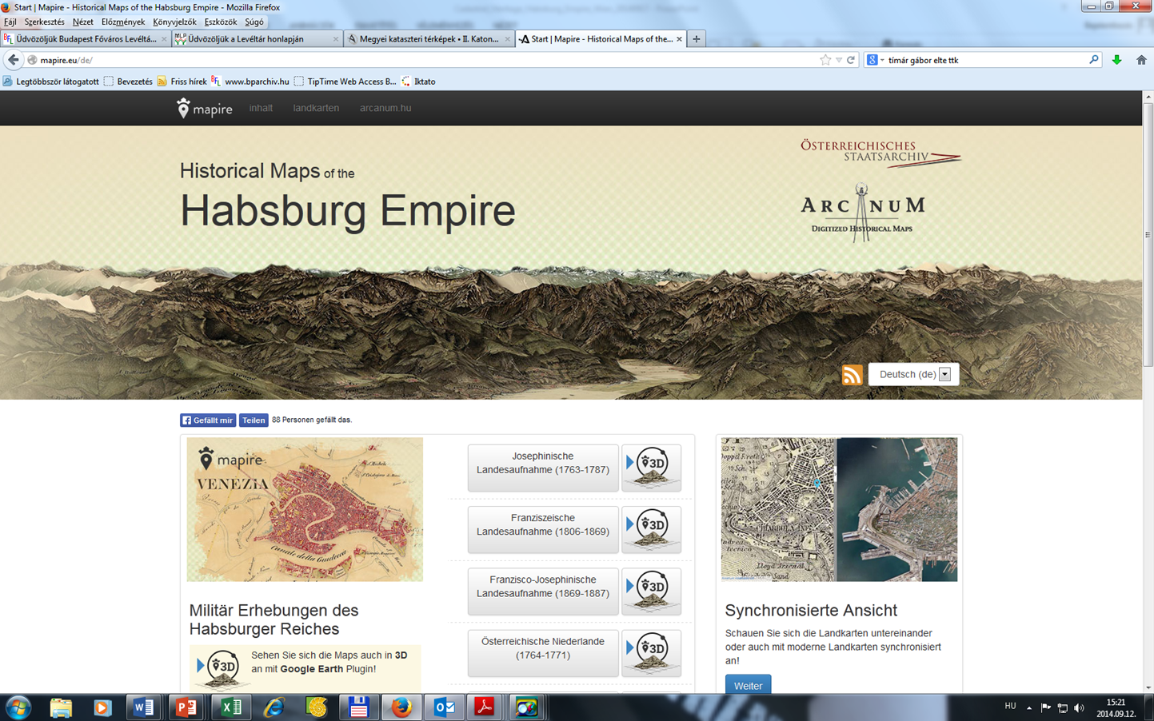
2014 – MAPIRE

Slide 10
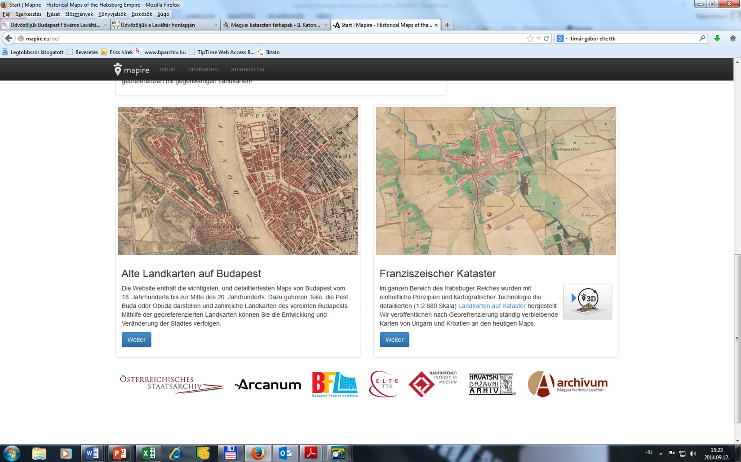
2014 – MAPIRE
Collection of 35 maps of Budapest from 18th to the second half of 20th centuries

Slide 11
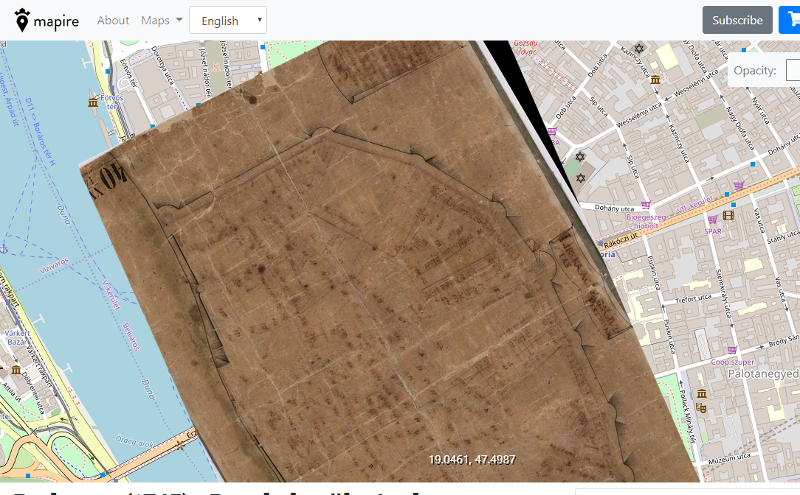
MAPIRE – BUDAPEST MAPS
Historical maps of Budapest
35 maps from the 18th to the 20th centuries
scales from 1:720 to 1:10.000

Slide 12
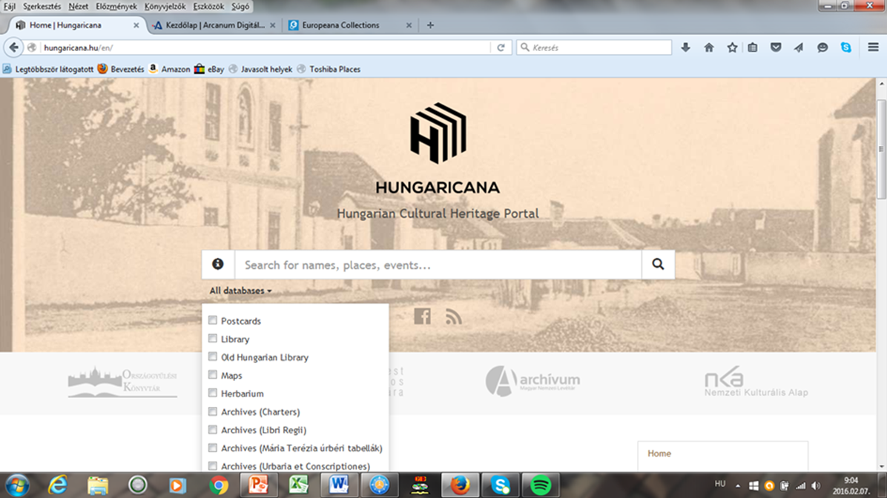
2015 - Hungaricana Cultural Heritage Portal www.hungaricana.hu
A joint database of Archives, Museums and Libraries – search of metadata and digital content by one click
Budapest City Arhives (BCA) is a princiapal content provider to Hungaricana:
nearly 1,5 million records with 1,5 million digital images
Developer: Arcanum Ltd., Budapest

Slide 13
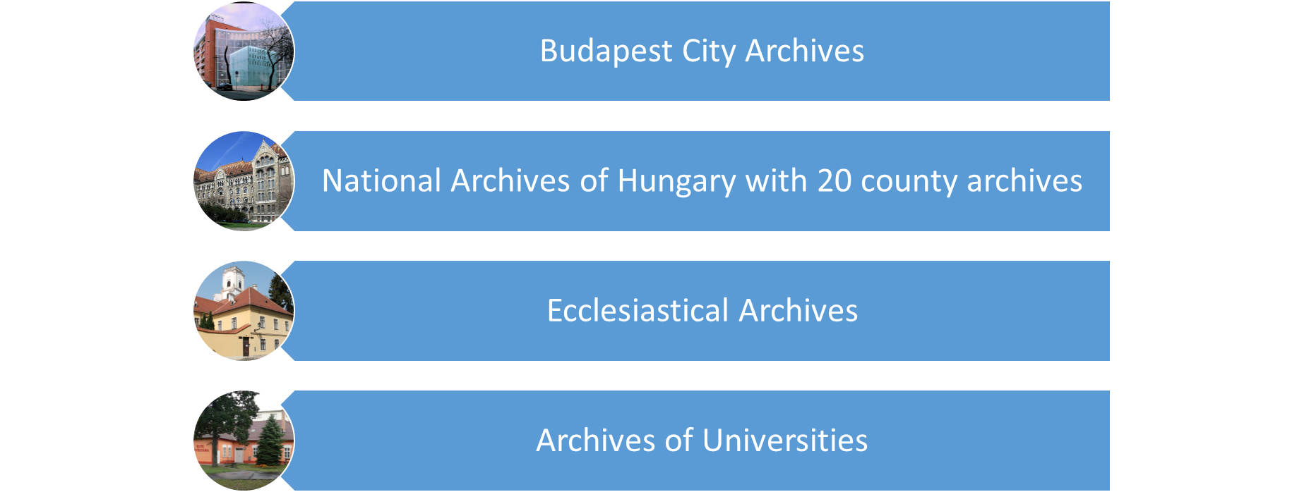
Archival content on Hungaricana

Slide 15
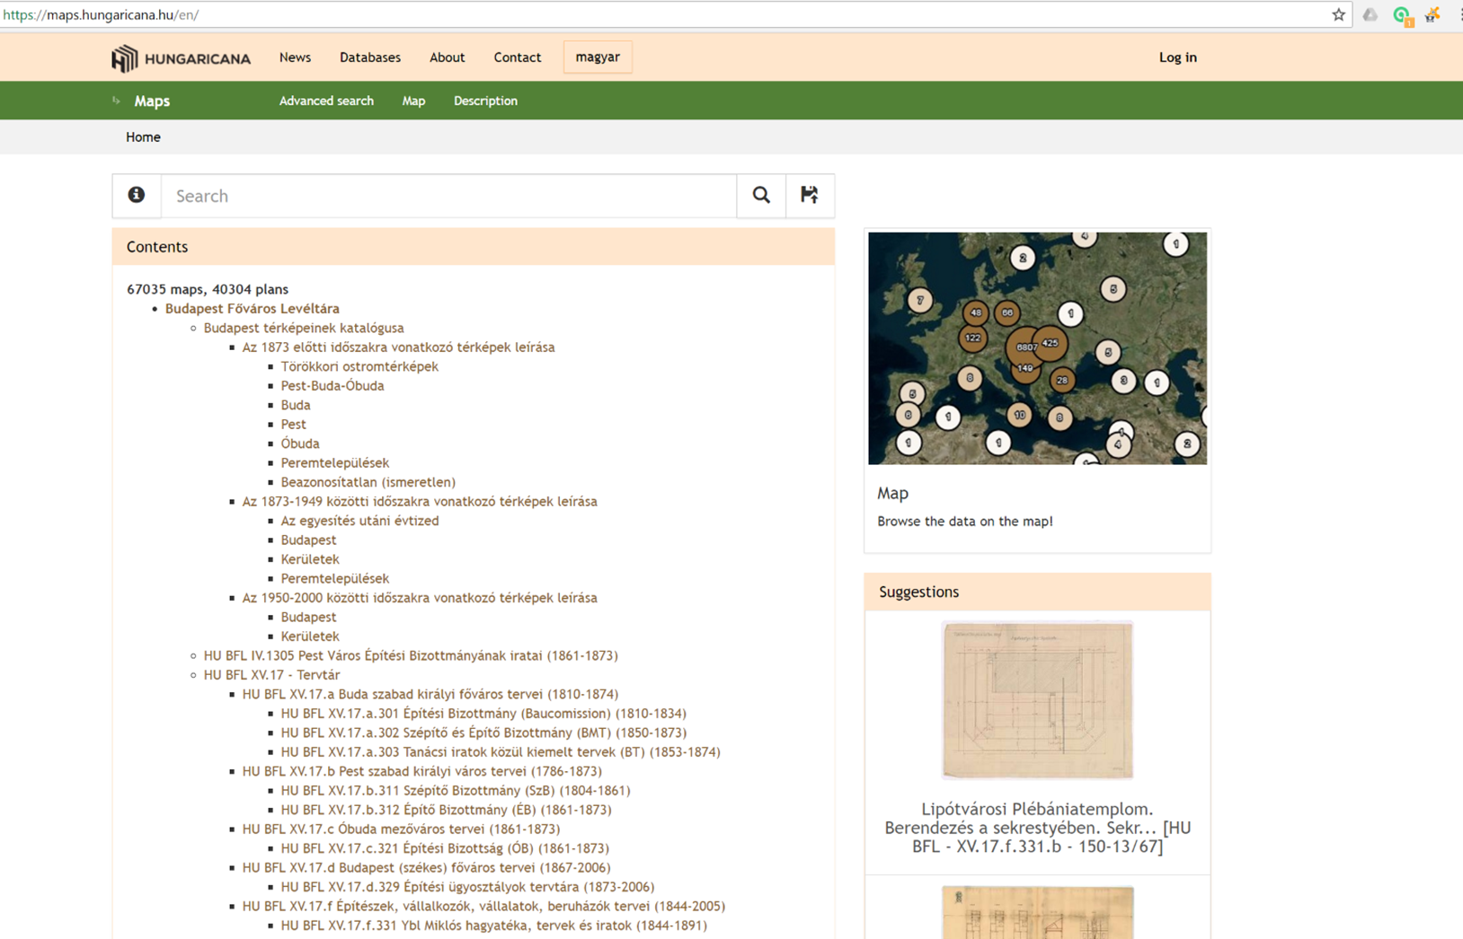

Slide 16
Budapest historical topography

Slide 17
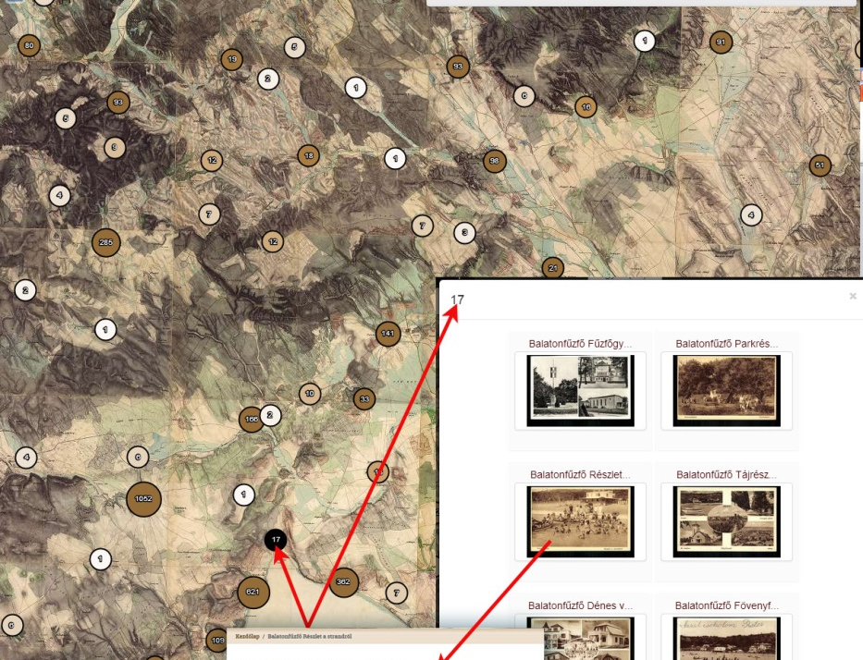
Display of cultural digital data using the Historical Geographical Information System – Data on maps, Hungaricana
Postcards: cca. 200,000 postcards
Map on map: cca. 10,000 maps can be found on maps
’Urbarium’ of 1767 (census) of Maria Theresa: all the 7,000 villages were identified, so the sources can be read on the maps
The plans and records of the Pest Construction Committee 1861-1873

Slide 18
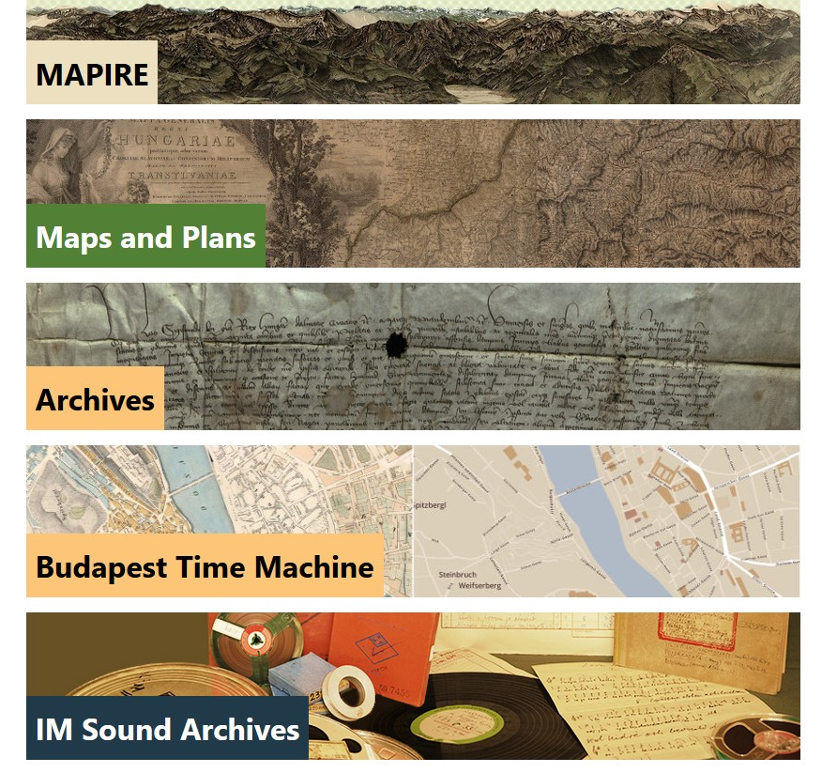
2017 – Budapest Time Machine
is integrated to Hungaricana – joint database of archives, libraries and museums www.hungaricana.hu
exploits the content of the Hungaricana database
connection of the records of the joint database with topographical data to georeferenced and vectorized maps

Slide 19
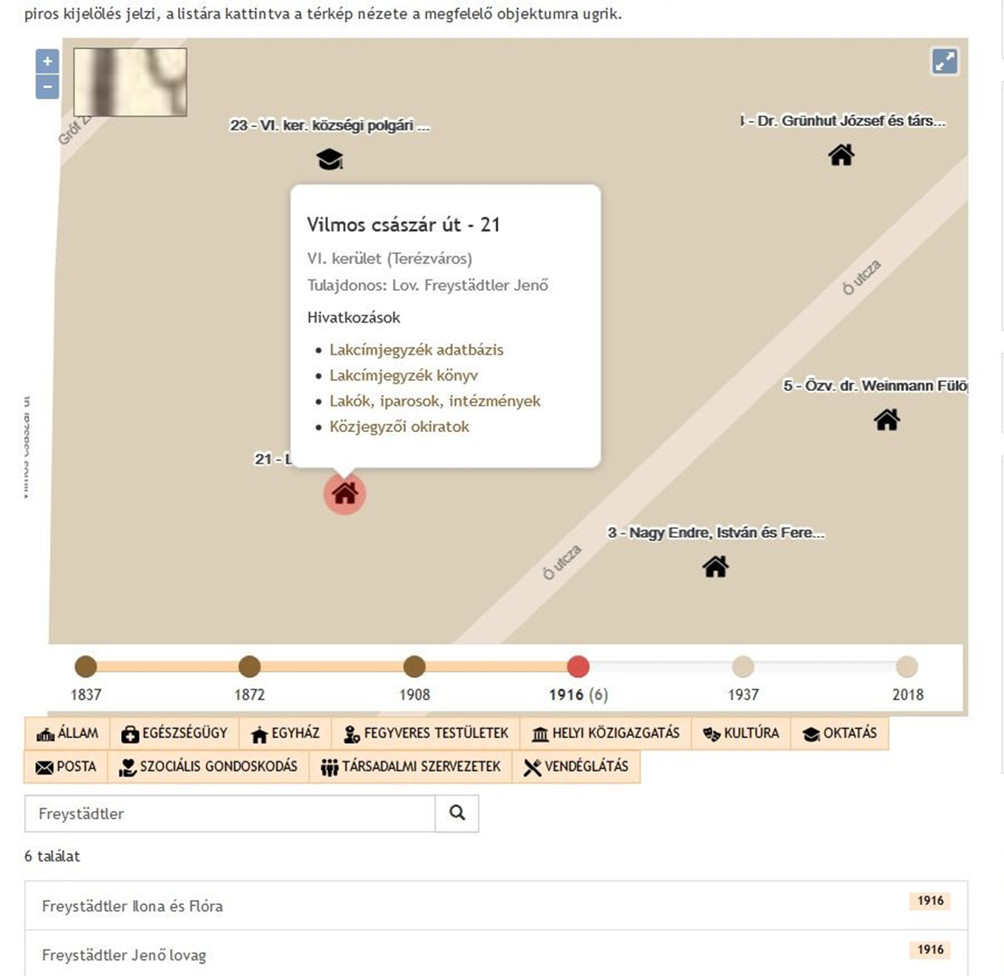
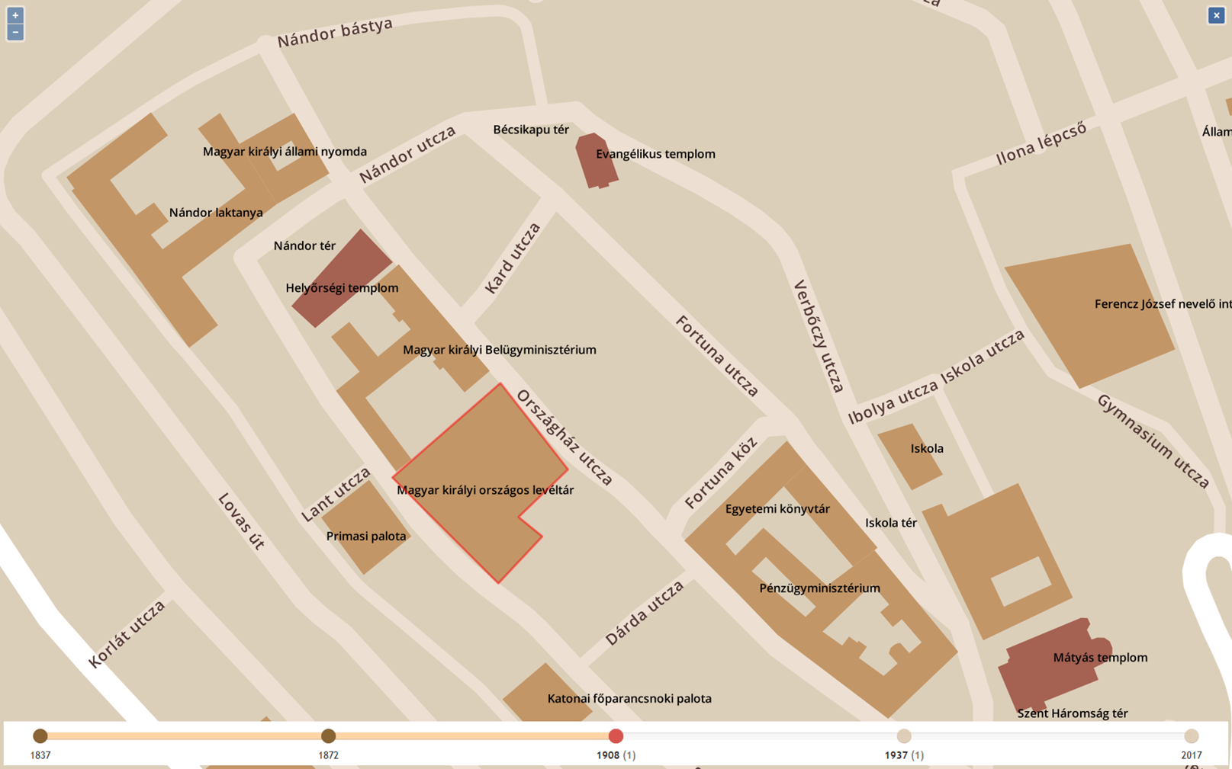
Vectorized versions of the most detailed maps from five different time periods (1837, 1872, 1908, 1916, 1937)
Database of all data on the maps, search with one click: street names, neighbourhoods, buildings, objects, old plot numbers…
Data of the Budapester Adressen und Wohnungs Anzeiger, 1916

Slide 20
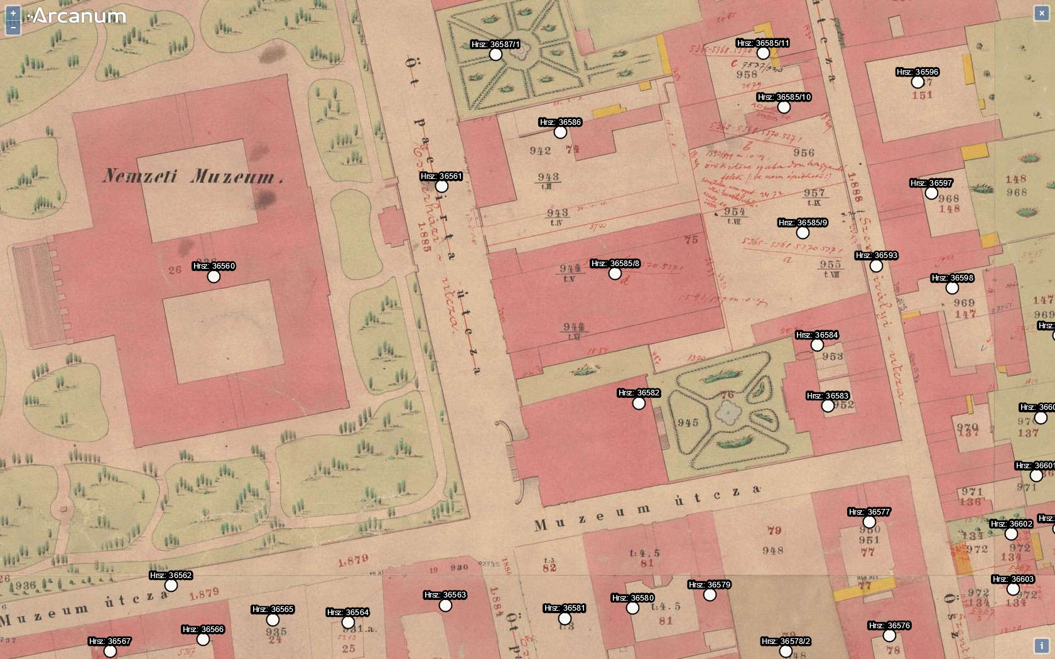
Interactive map with property lot numbers – view and open related archival documents from Hungaricana databases via hyperlinks
Count Alajos Károlyi’s Palace
1863-1879

Slide 21
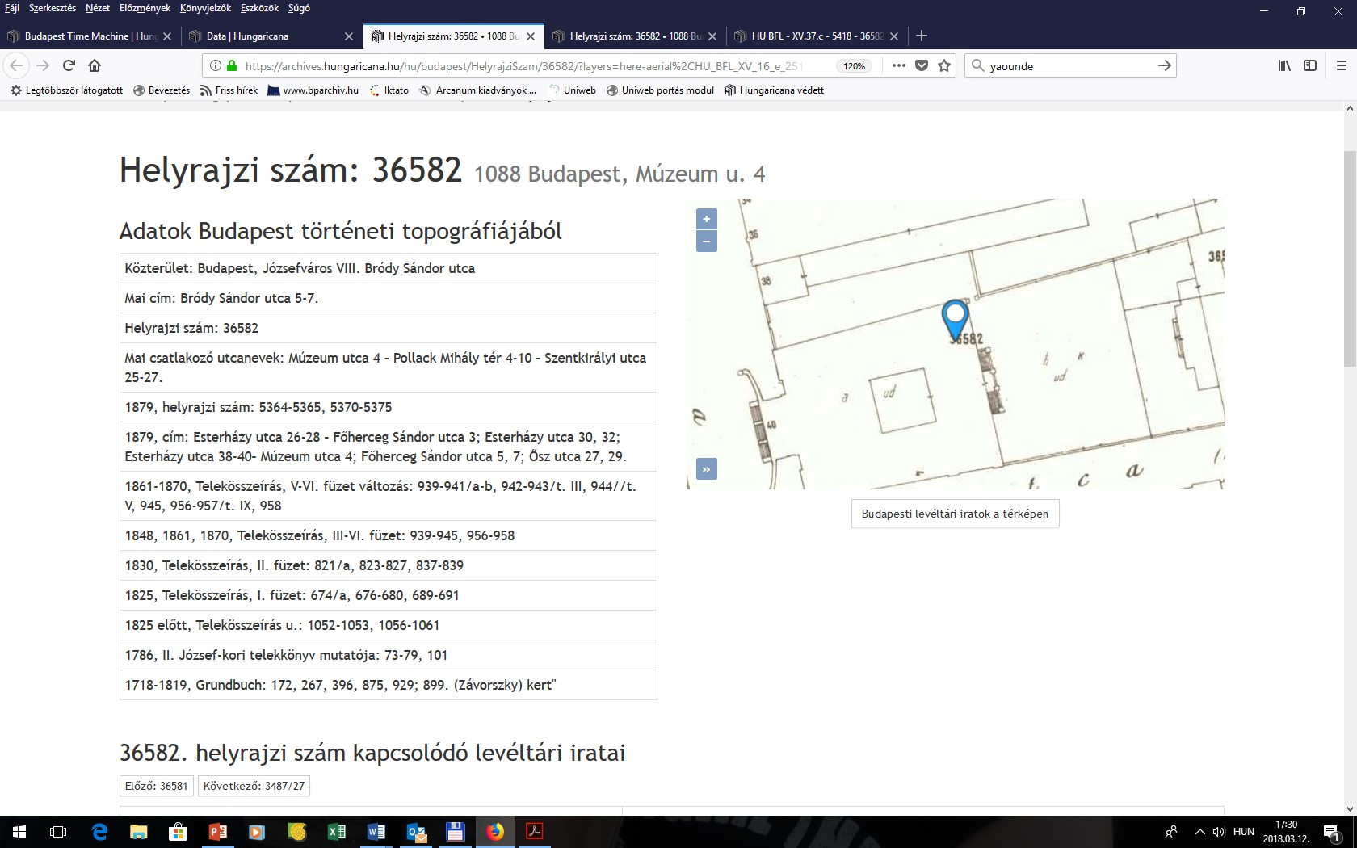
Károlyi’s Palace - historical topography of the plot and position on the map 1937

Slide 22
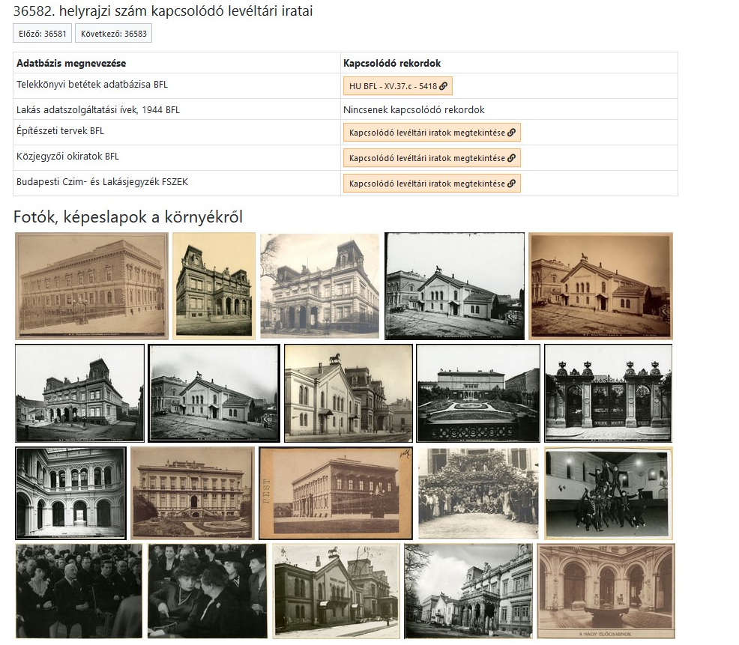
Károlyi’s Palace – related archival documents
Open and wiev
Notarial deeds

Slide 23
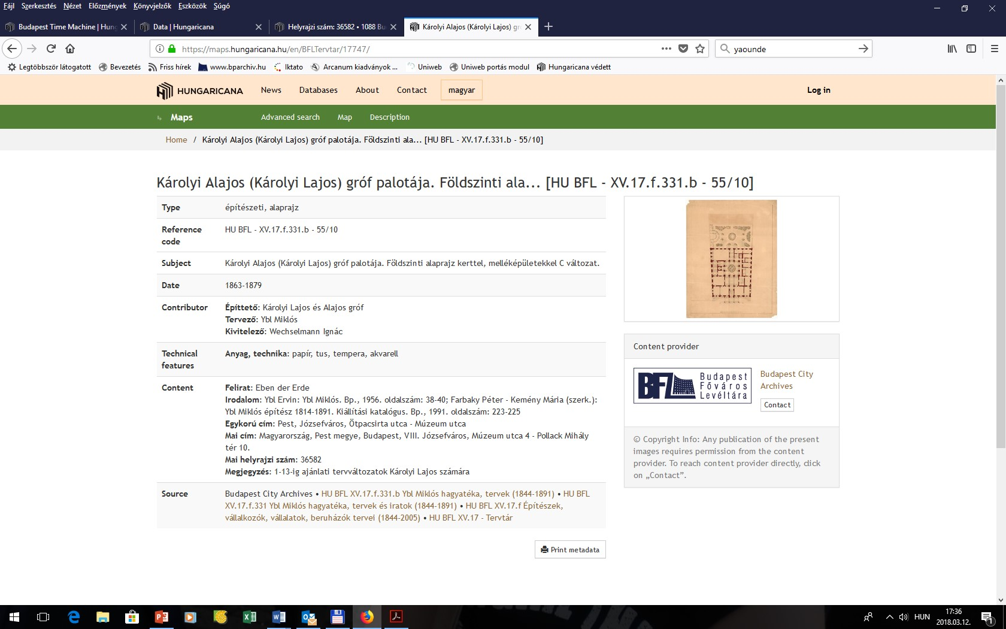
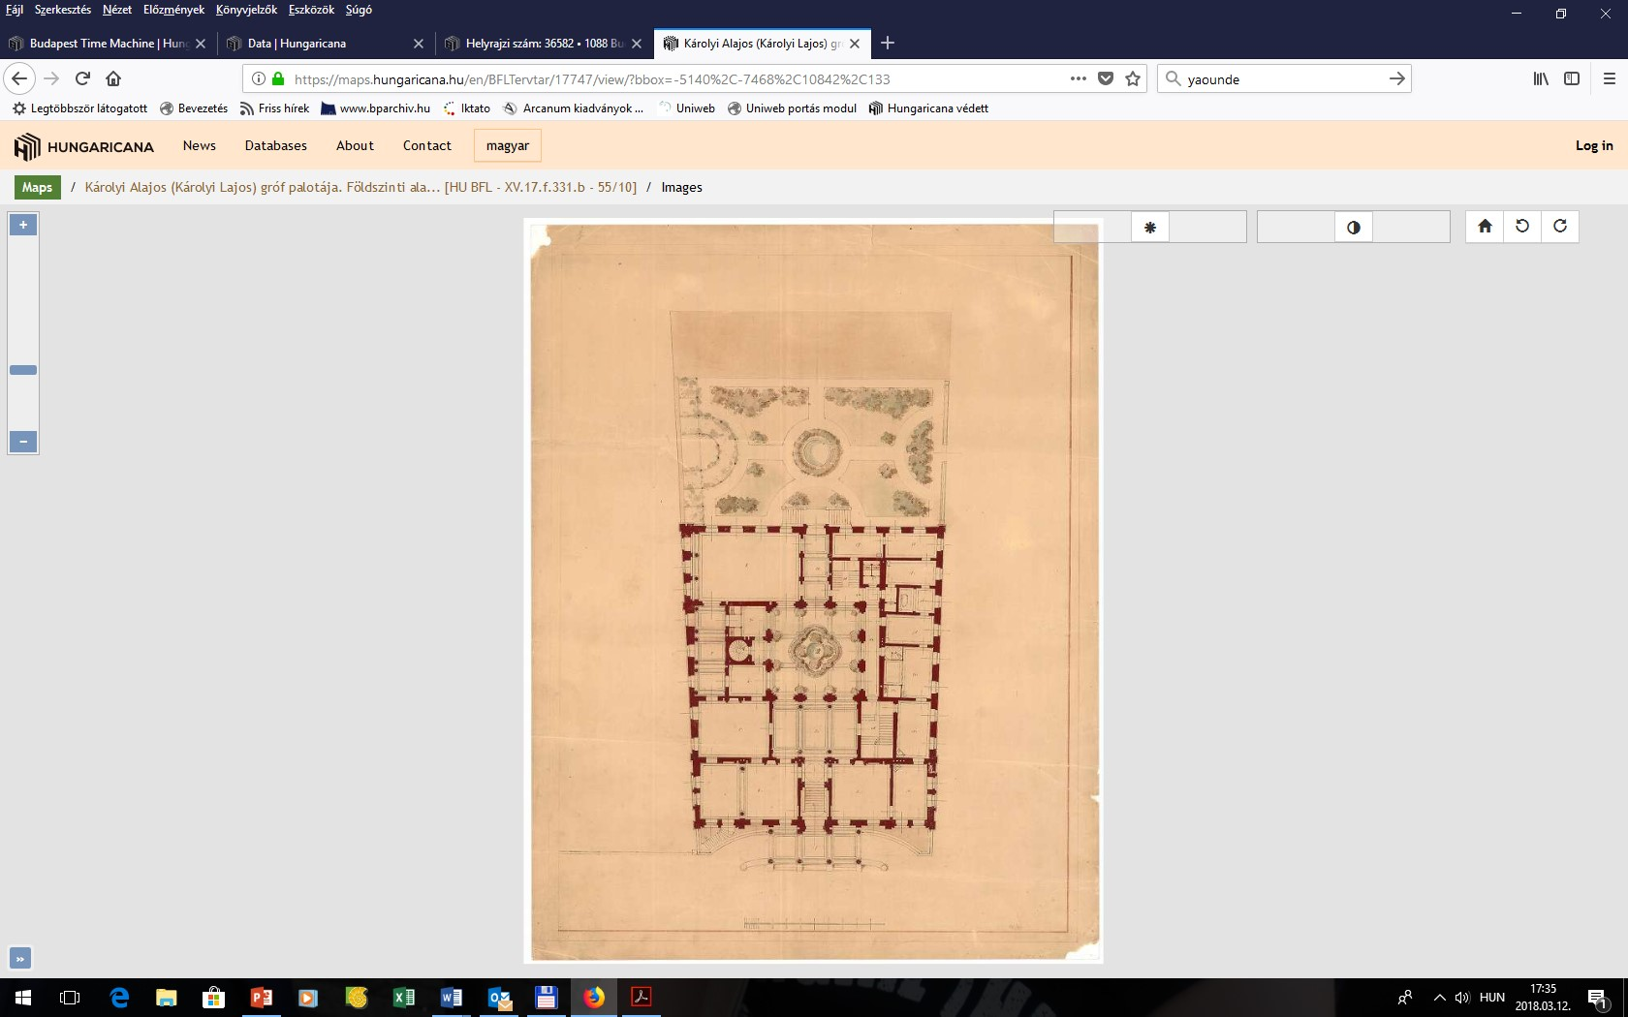
Károlyi’s Palace – images and descriptions of the architectural plans

Slide 24
Types of records on Hungaricana, which are already georeferenced and connected to Time Machine (bold)
Notarial records
Last wills, testaments
Inheritence files
Court files (penalty and civil suits)
Orphans’ Offiece files
Registers of prisons and penitentiary institutions
Architectural plans
Land registry records
Flat data sheets, 1944 (complete)
Photos
Hungaricana database is an unexhaustable reservoir of further development

Slide 25
Thank you for your attention!
Questions and comments:
siposa@bparchiv.hu

